Slide 1
How to Enter Plants
Atlanta Orchid Show
March 2019

Slide 2
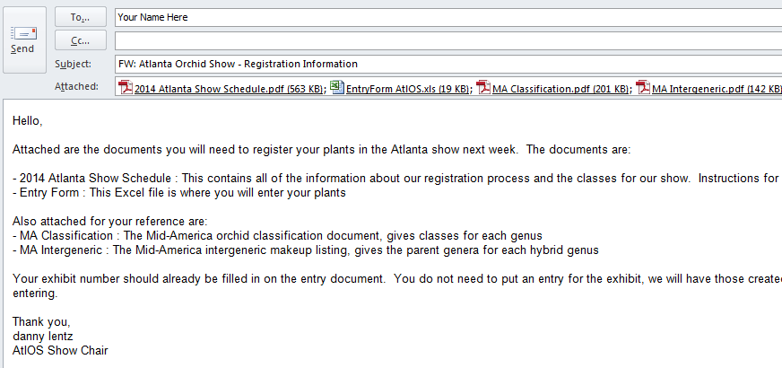

Slide 3
Show Schedule

Slide 4
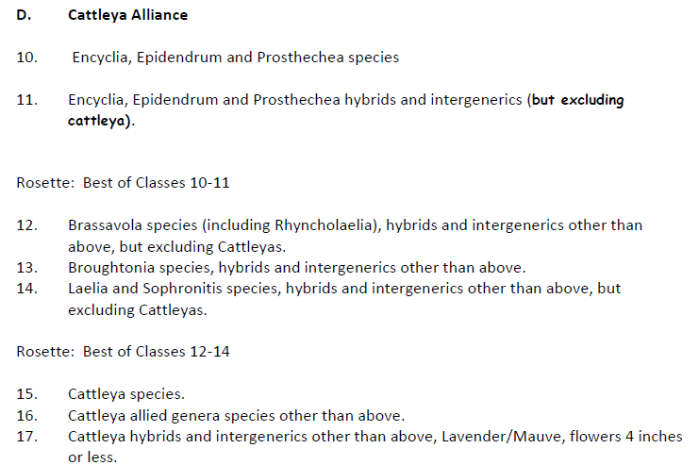
Orchid Class #
1-108
Exhibits Classes 1-9
Plants Classes 10-102
Non-Plants Classes 103-108

Slide 5
Special Rules
Specimen plants can be entered in two classes
Class 102 specimen plant
Class 11 to 101 the original class
Seedling flowering for the first time, Classes 10 through 100, entered in Class 101.
Can also be entered into its original class
Number of plants
An exhibitor can enter any number of plants per class

Slide 6
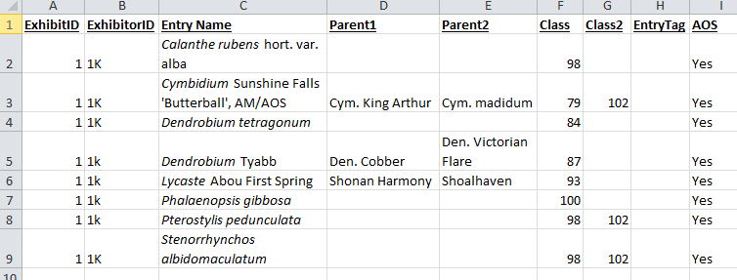

Slide 7
What Do the Columns Mean
Exhibit ID
Exhibitor ID
The number assigned to the AtlOS exhibit. It will be in your email from Danny.
You pick a letter to use with the AtlOS Exhibit ID number (e.g,. 1L).
If you are entering plants for someone else, assign them a different letter
Include a list of exhibitors you are entering plants for (e.g., 1L Danny Lentz; 1M David Mellard)

Slide 8
Columns, continued
Entry Name
Parent 1
Parent 2
Class
Class 2
name of species or hybrid
if a hybrid, the names of both parents
Class number from the show schedule
If applicable (e.g., specimen plants)

Slide 9
Columns, continued
Entry tag
AOS
If you enter more than one plant of the same species or hybrid in the same class, assign the plants A, B, C etc.
Enter yes to have your plant eligible for AOS judging

Slide 10
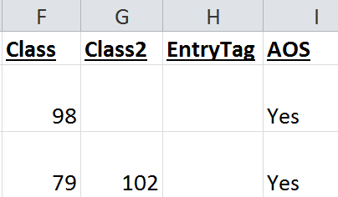

Slide 11
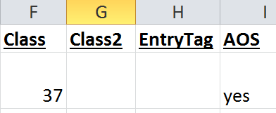
Paphiopedilum (venustum x Winston Churchill)

Slide 12
Entry deadline: 6:30 pm (Thursday)
Return Excel file in an email to Danny Lentz or Bring to Day Hall on Thursday

Slide 13
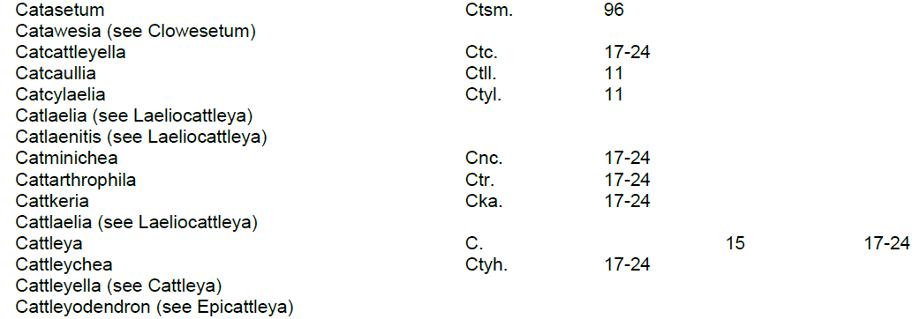

Slide 15
Verifying Genus and Species Names
http://apps.kew.org/wcsp/prepareChecklist.do;jsessionid=C9EA1D225C4D20B8E9ABC27D7C3BB7BC?checklist=selected_families%40%40038070220152253173

Slide 16
Lists Accepted Names and Synonyms

Slide 17
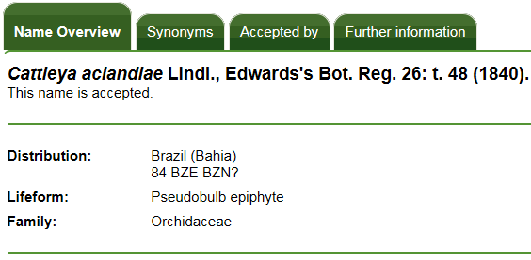
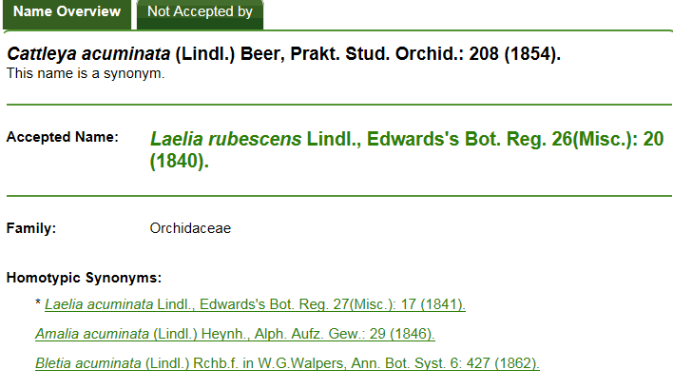

Slide 18
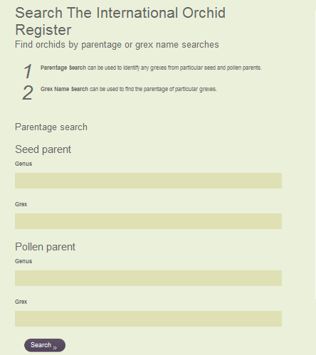
http://apps.rhs.org.uk/horticulturaldatabase/orchidregister/orchidregister.asp

Slide 19
Example of Searching by Parents

Slide 20
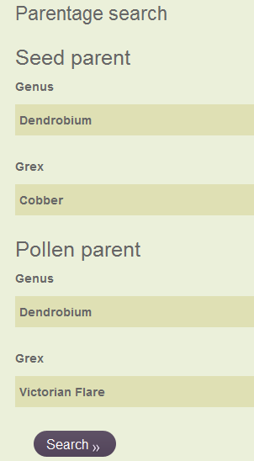
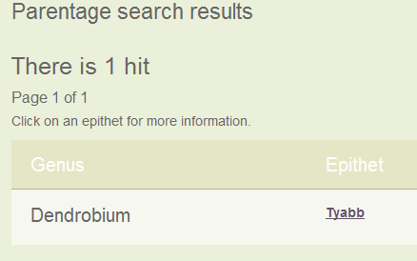
Switch Grex Names
.

Slide 21
How to Search by Hybrid (Grex) Name: Cymbidium Sunshine Falls ‘Butterball’, AM/AOS
Note: Do not enter cultivar name or award

Slide 22
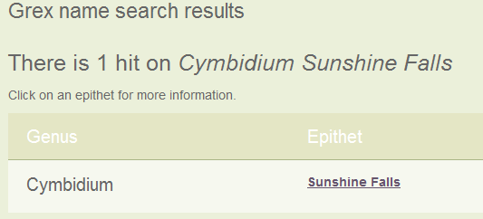
Grex Search Results
.
Click on Sunshine Falls

Slide 23
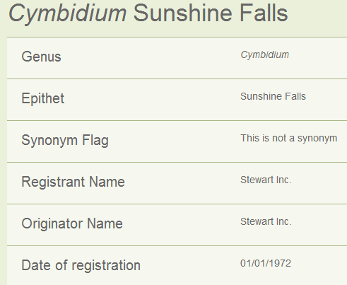

Slide 24
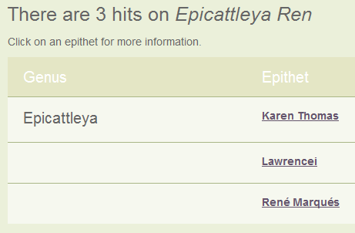
Some Special Searches: Epicattleya René Marqués

